Slide 1
Digital Portfolio
STUDENT NAME: J.SANJAY REGISTER NO:212402421 NMID:asunm1301212402421 DEPARTMENT: BCA
COLLEGE: COLLEGE/ UNIVERSITY:A.M JAIN COLLEGE, MADRAS UNIVERSITY

Slide 2
STUDENT PORTFOLIO

Slide 3


AGENDA
Problem Statement
Project Overview
End Users
Tools and Technologies
Portfolio design and Layout
Features and Functionality
Results and Screenshots
Conclusion
Github Link
3/21/2024 Annual Review

Slide 4

PROBLEM STATEMENT
In today's competitive digital landscape, individuals often struggle
to effectively showcase their skills, work, and personal brand online. Without a personal portfolio, it's difficult to stand out to potential employers, collaborators, or clients. The lack of a centralized, visually appealing, and professional platform limits career opportunities and personal branding.

Slide 5

PROJECT OVERVIEW
This project is a personal portfolio website developed using HTML, CSS, and JavaScript. The portfolio introduces me, displays my academic achievements, certificates, education background, and provides direct communication through a contact form. The design is made visually appealing with background GIF animations, smooth navigation, and interactive certificate pop-ups.

Slide 6

WHO ARE THE END USERS?
Recruiters and hiring managers looking to assess technical and creative skills
Clients or businesses interested in digital marketing, automation,or web development services Collaborators or peers in tech/startups seeking partnerships
General audience interested in learning more about my work and skills

Slide 7

TOOLS AND TECHNIQUES
HTML → for webpage structure.
CSS → for styling, layout, and animations.
JavaScript → for interactivity (certificate popup, navigation). Browser & Code Editor → Chrome, VS Code

Slide 8
POTFOLIO DESIGN AND LAYOUT
The portfolio is divided into clear sections with a navigation bar: Home , About Me → Profile picture, introduction, and short bio.
Education → My academic background and course details. Contact → Email form for visitors to reach me.

Slide 9
FEATURES AND FUNCTIONALITY
Responsive Design – Works seamlessly across desktops, tablets, and smartphones.
Smooth Scrolling – Enhanced UX for navigating between sections.
Call-to-Action Buttons – Encourage users to explore work or contact.
interactive "Career Finder" Project – Showcases a real-world solution.
Contact Form – Collects messages from visitors
Scroll-based Back-to-Top Button – Improves navigation experience.

Slide 10
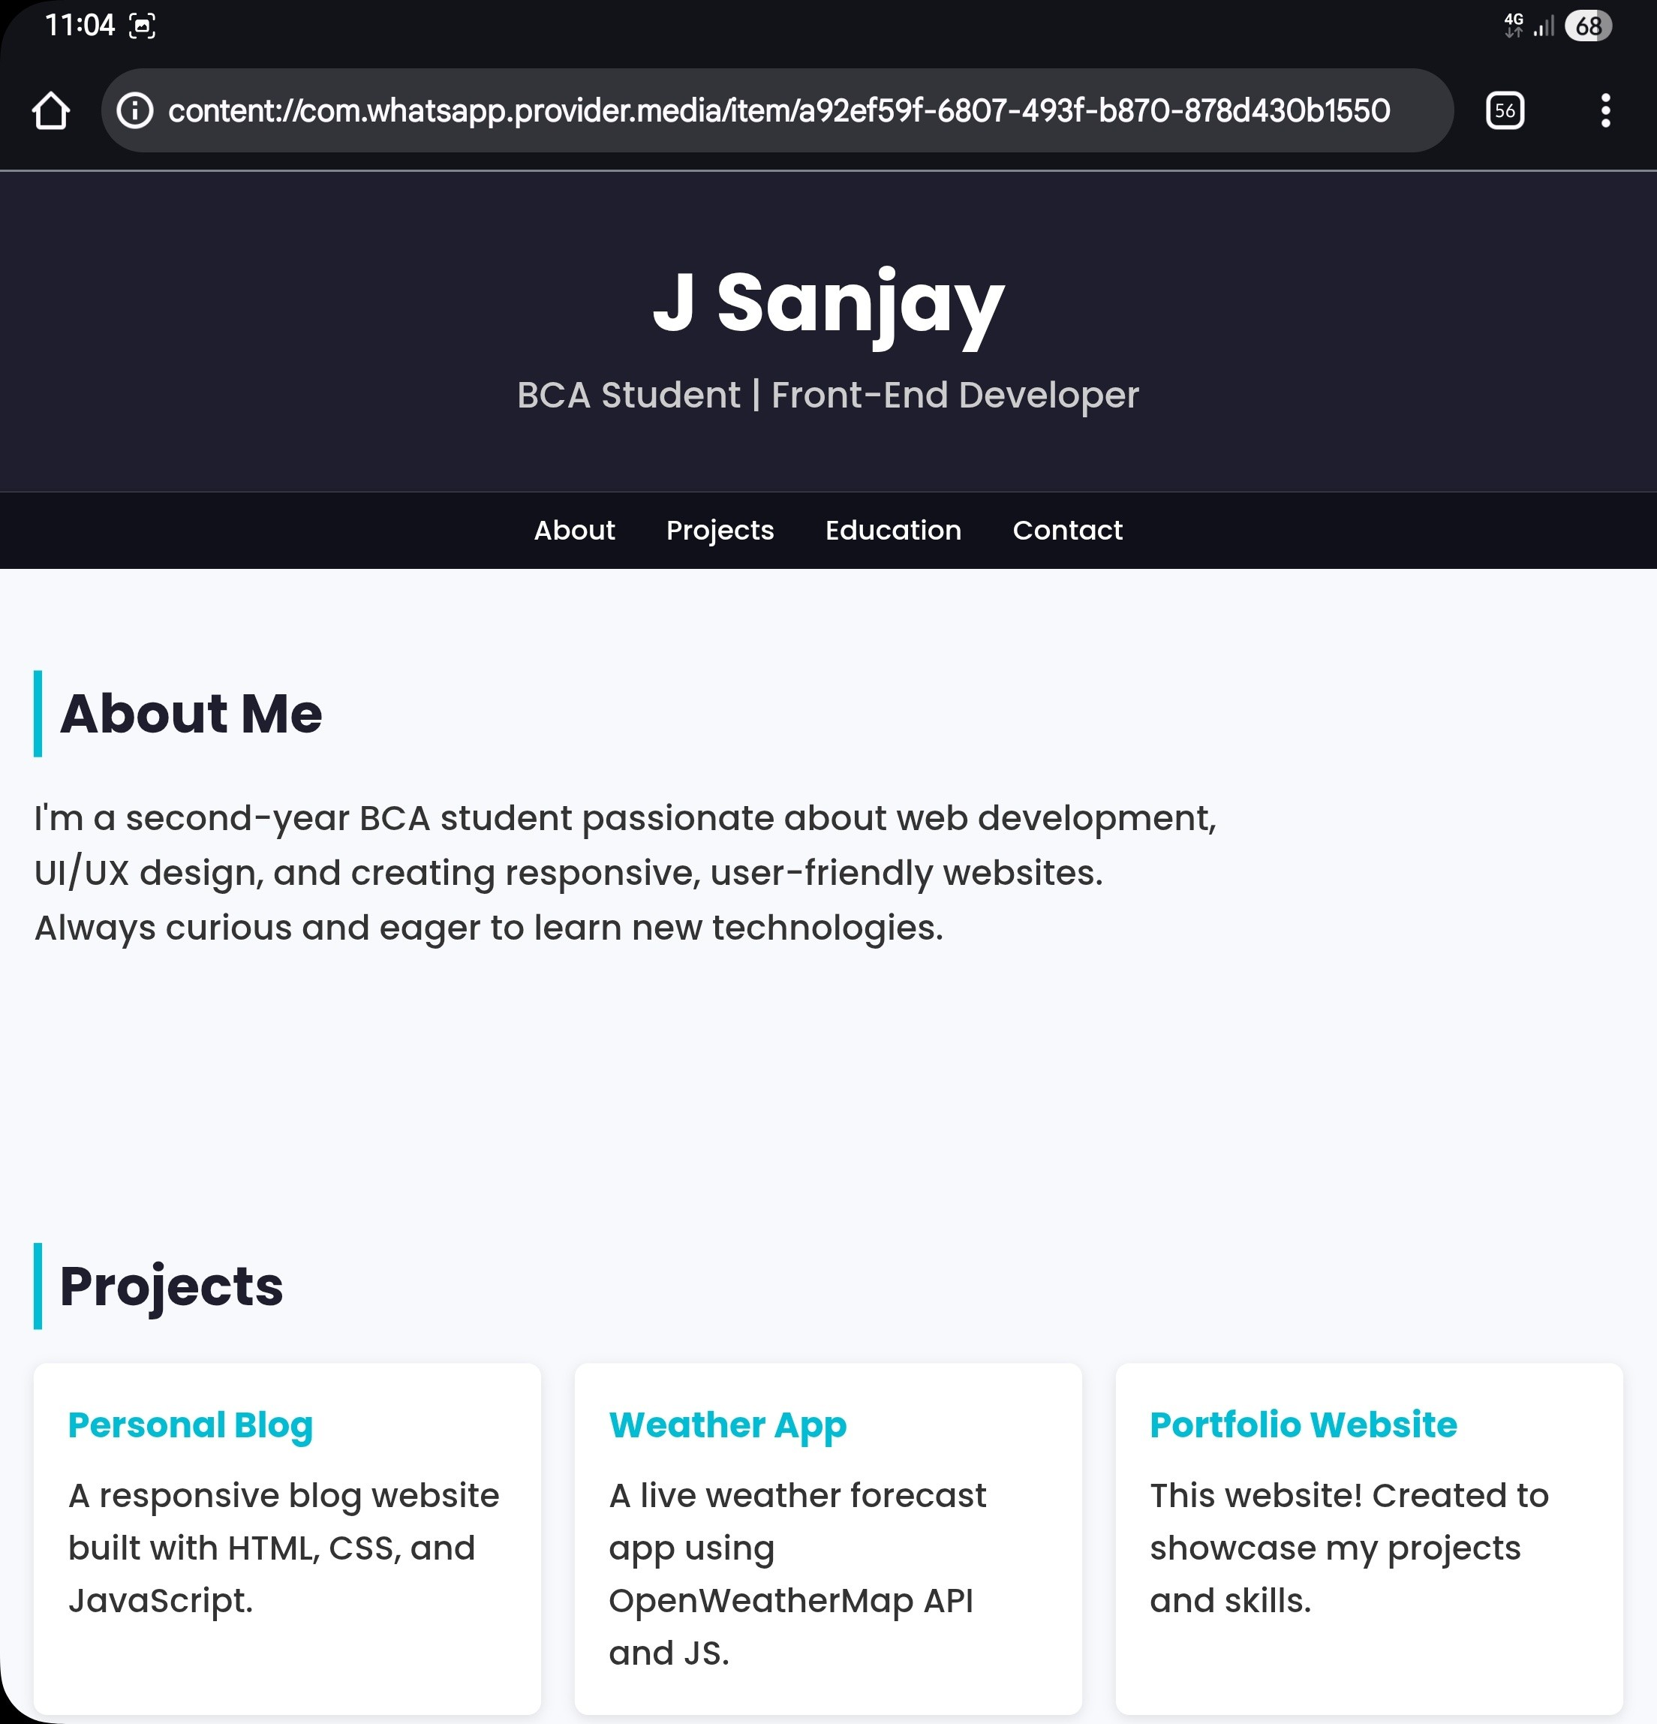
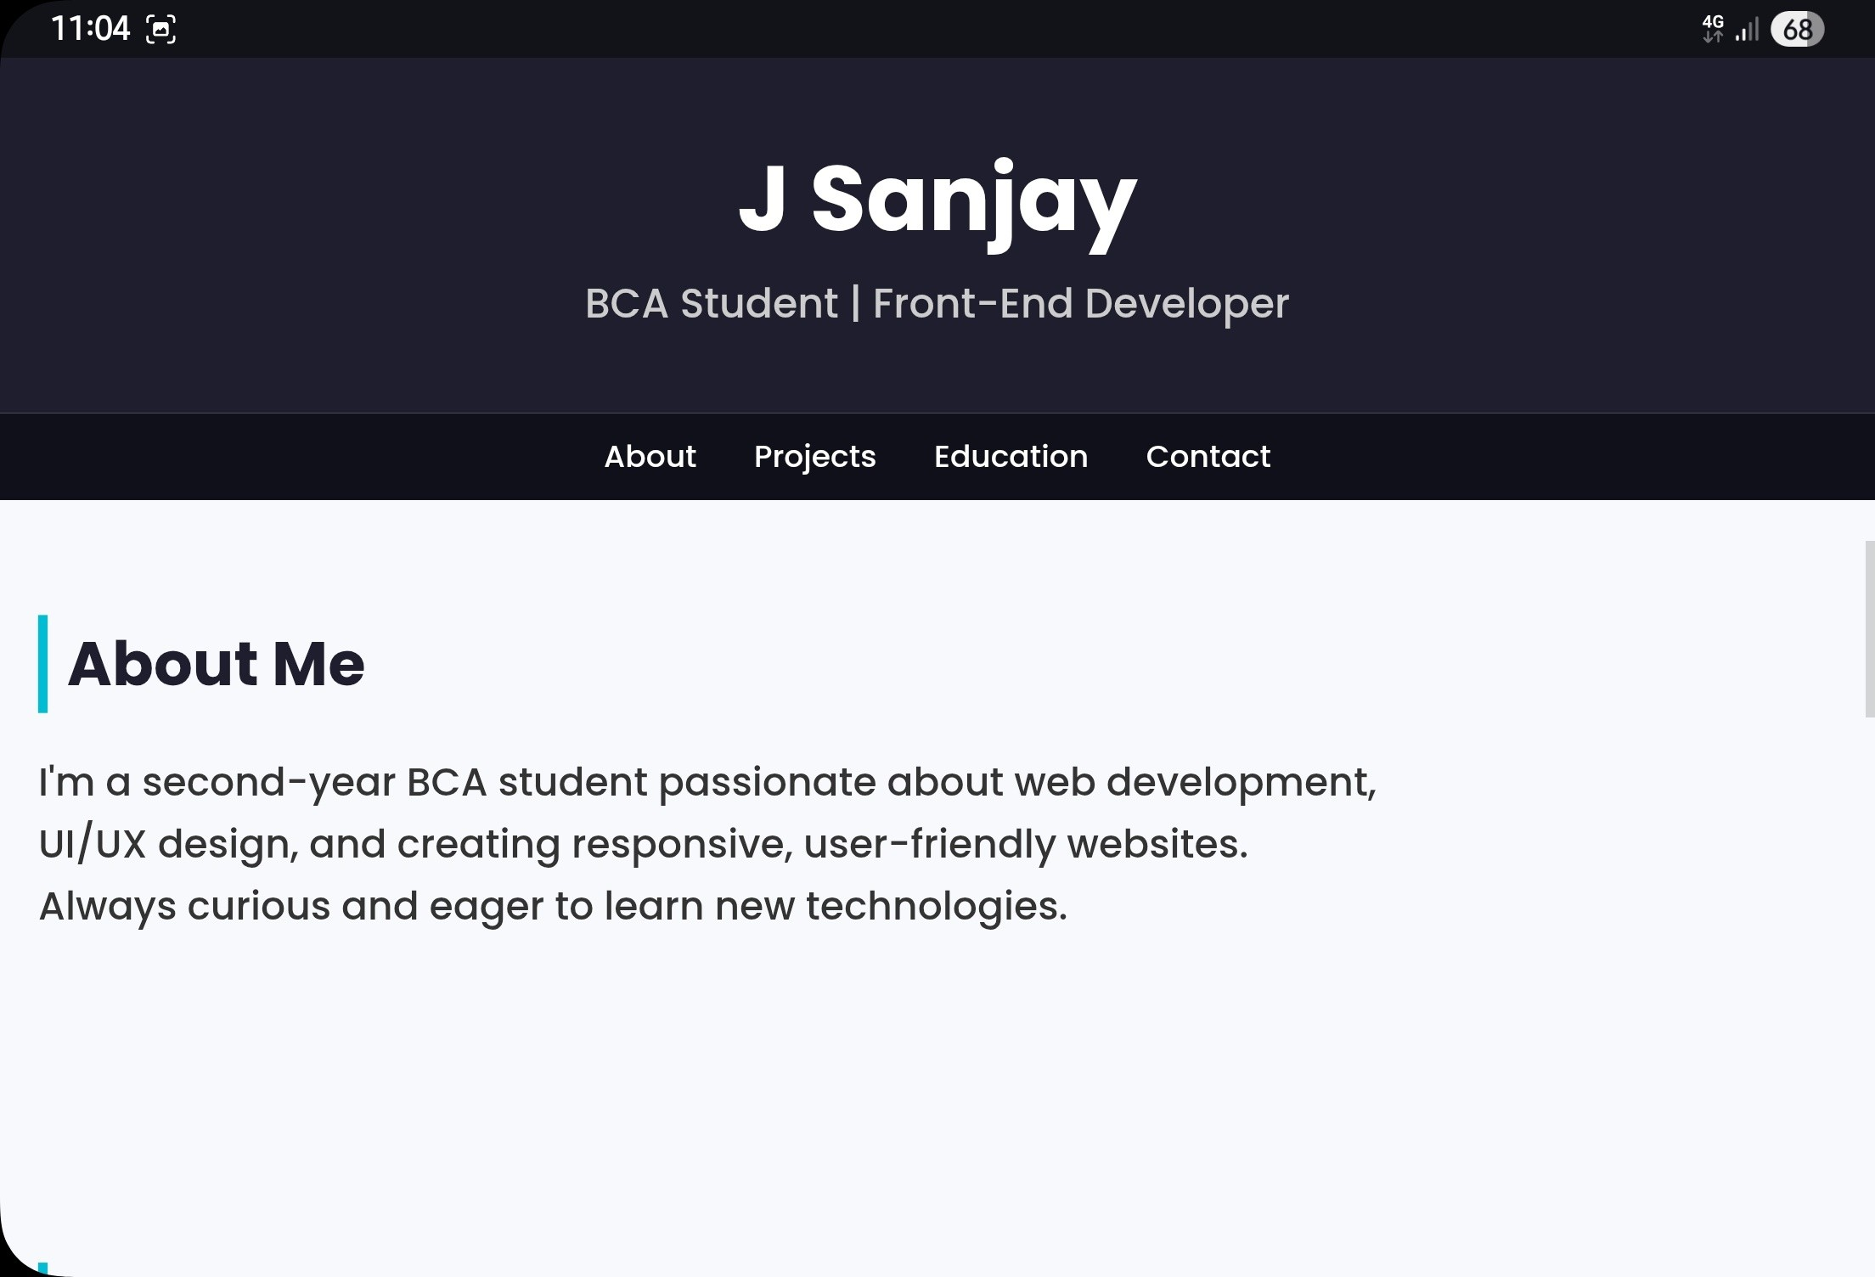

RESULTS AND SCREENSHOTS
1.
2.
3/21/2024 Annual Review

Slide 11
CONCLUSION
This personal portfolio project effectively showcases my skills, creativity, and professional experience in a visually engaging and user-friendly manner. With a clean layout, responsive design, and interactive features like smooth scrolling and a mobile-friendly menu, it serves as a powerful digital identity. By highlighting key strengths and a featured project, it not only builds personal branding but also opens doors to career opportunities, collaborations, and client engagements.

